Slide 1
An automated approach for task evaluation using EEG signals
under the guidance of
Dr. Debasis Samanta

Slide 2

BTech Project | IIT Kharagpur
Presented by
Vishal Anand
Zaki Ahmed

Slide 3
Aim
The objective of this project is the identification of Mental workload generated in an individual while performing different tasks using EEG Data signals.

Slide 4
Outline
Structure, Parts and function of Brain
EEG Device overview
Design of Experiment
Data Collection
Signal Preprocessing
Feature Extraction
Feature Selection
Machine Learning Modelling
Confusion Matrix and Accuracy of all models
Conclusion

Slide 5
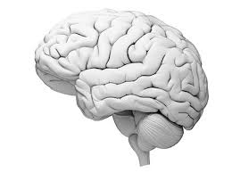
Brain

Slide 6
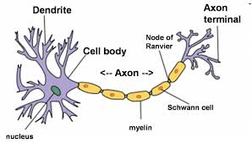
The Neuron

Slide 7
Parts of Brain
Cerebrum
Frontal lobe
Parietal lobe
Occipital Lobe
Temporal lobe
Cerebellum
Brain Stem

Slide 8
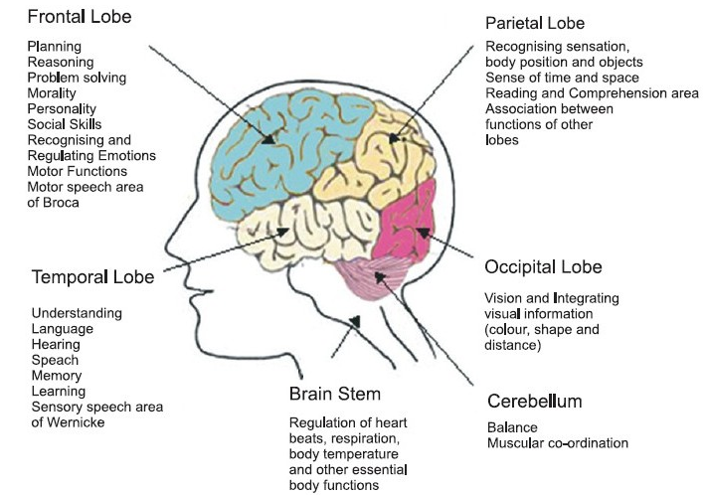

Slide 9
Electroencephalography (EEG)
Monitoring method to record the electrical activity of the brain
measures voltage fluctuations resulting from ionic current within the neurons of the brain

Slide 10
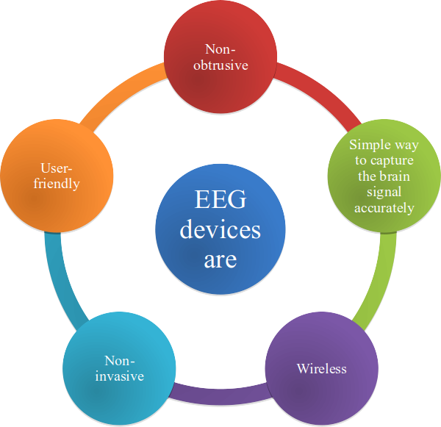

Slide 11
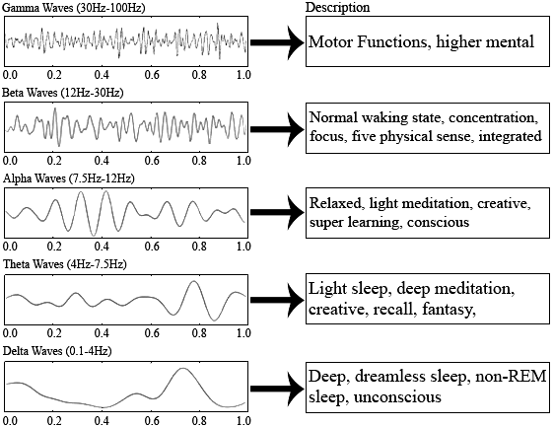
EEG Signals

Slide 12
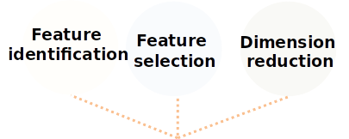
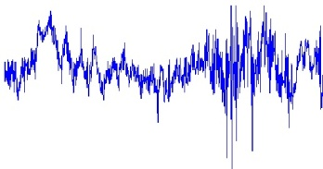

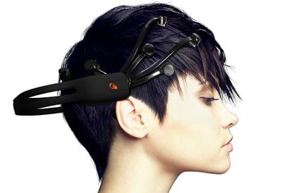
Signal
enhancement
Artifact
processing
Noise
removal
Signal Acquisition
BCI Signal Processing
Feature Engineering
Modeling
User’s Application
User
Emotion Recognition
Text-Entry System
Vigilance
Detection
Adaptive
E-learning
Post
processing
Feature
classification
Notes:
Change in diff form

Slide 13
Design of Experiment
Software used - Solidworks
3 different level of SolidWorks models - Level 1 , Level 2, Level 3
Collected EEG data of 8 subjects during the experiment
14 Channel Emotiv EEG device used
Data collected at 3 times of day per subject
Models were shuffled to remove bias and practise.
Channel frequency : 128hz
Notes:
Create a model and take a video of the model creation

Slide 14
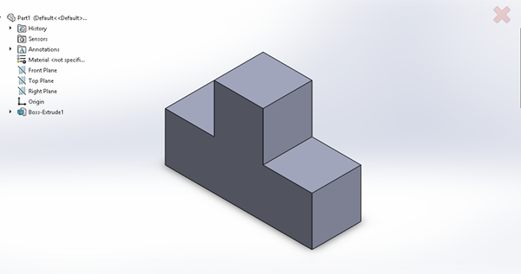
Level 1
Complexity type : Level 1
No. of tools used : 2*
Time taken : 50 seconds
* Sketch and Extrude tools were used.

Slide 15
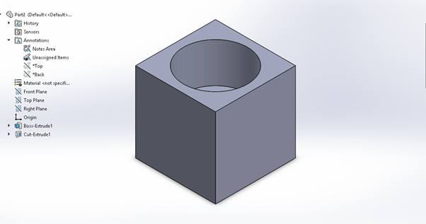
Level 2
Complexity type : Level 2
No. of tools used : 3*
Time taken : 110 seconds
* Sketch, Extrude and Extrude cut tools were used

Slide 16
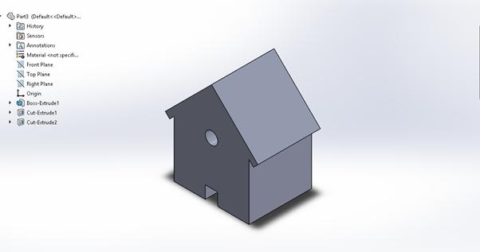
Level 3
Complexity type : Level 3
No. of tools used : 4*
Time taken : 170 seconds
*Sketch, Extrude, Extrude cut and mirror transform

Slide 17
Details of the experiment
Each subject was told to build 3 models of various complexity with given time limit.
Each Trial Included the following step -
-The first 5 seconds of procedure was quite, subject was Idle
-At the beginning of 6th second the subject started building the model.
-Finally, after given time limit and 5s idle time after the experiment indicates the end of trial.
One Trial
First Idle Period | Experiment time(seconds) | Last Idle Period
5 seconds | 40/100/160 | 5 seconds

Slide 18
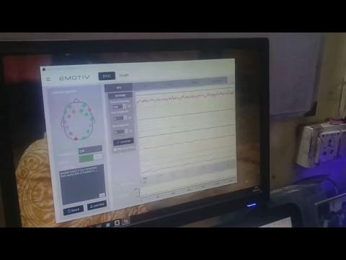
Data Collection

Slide 19
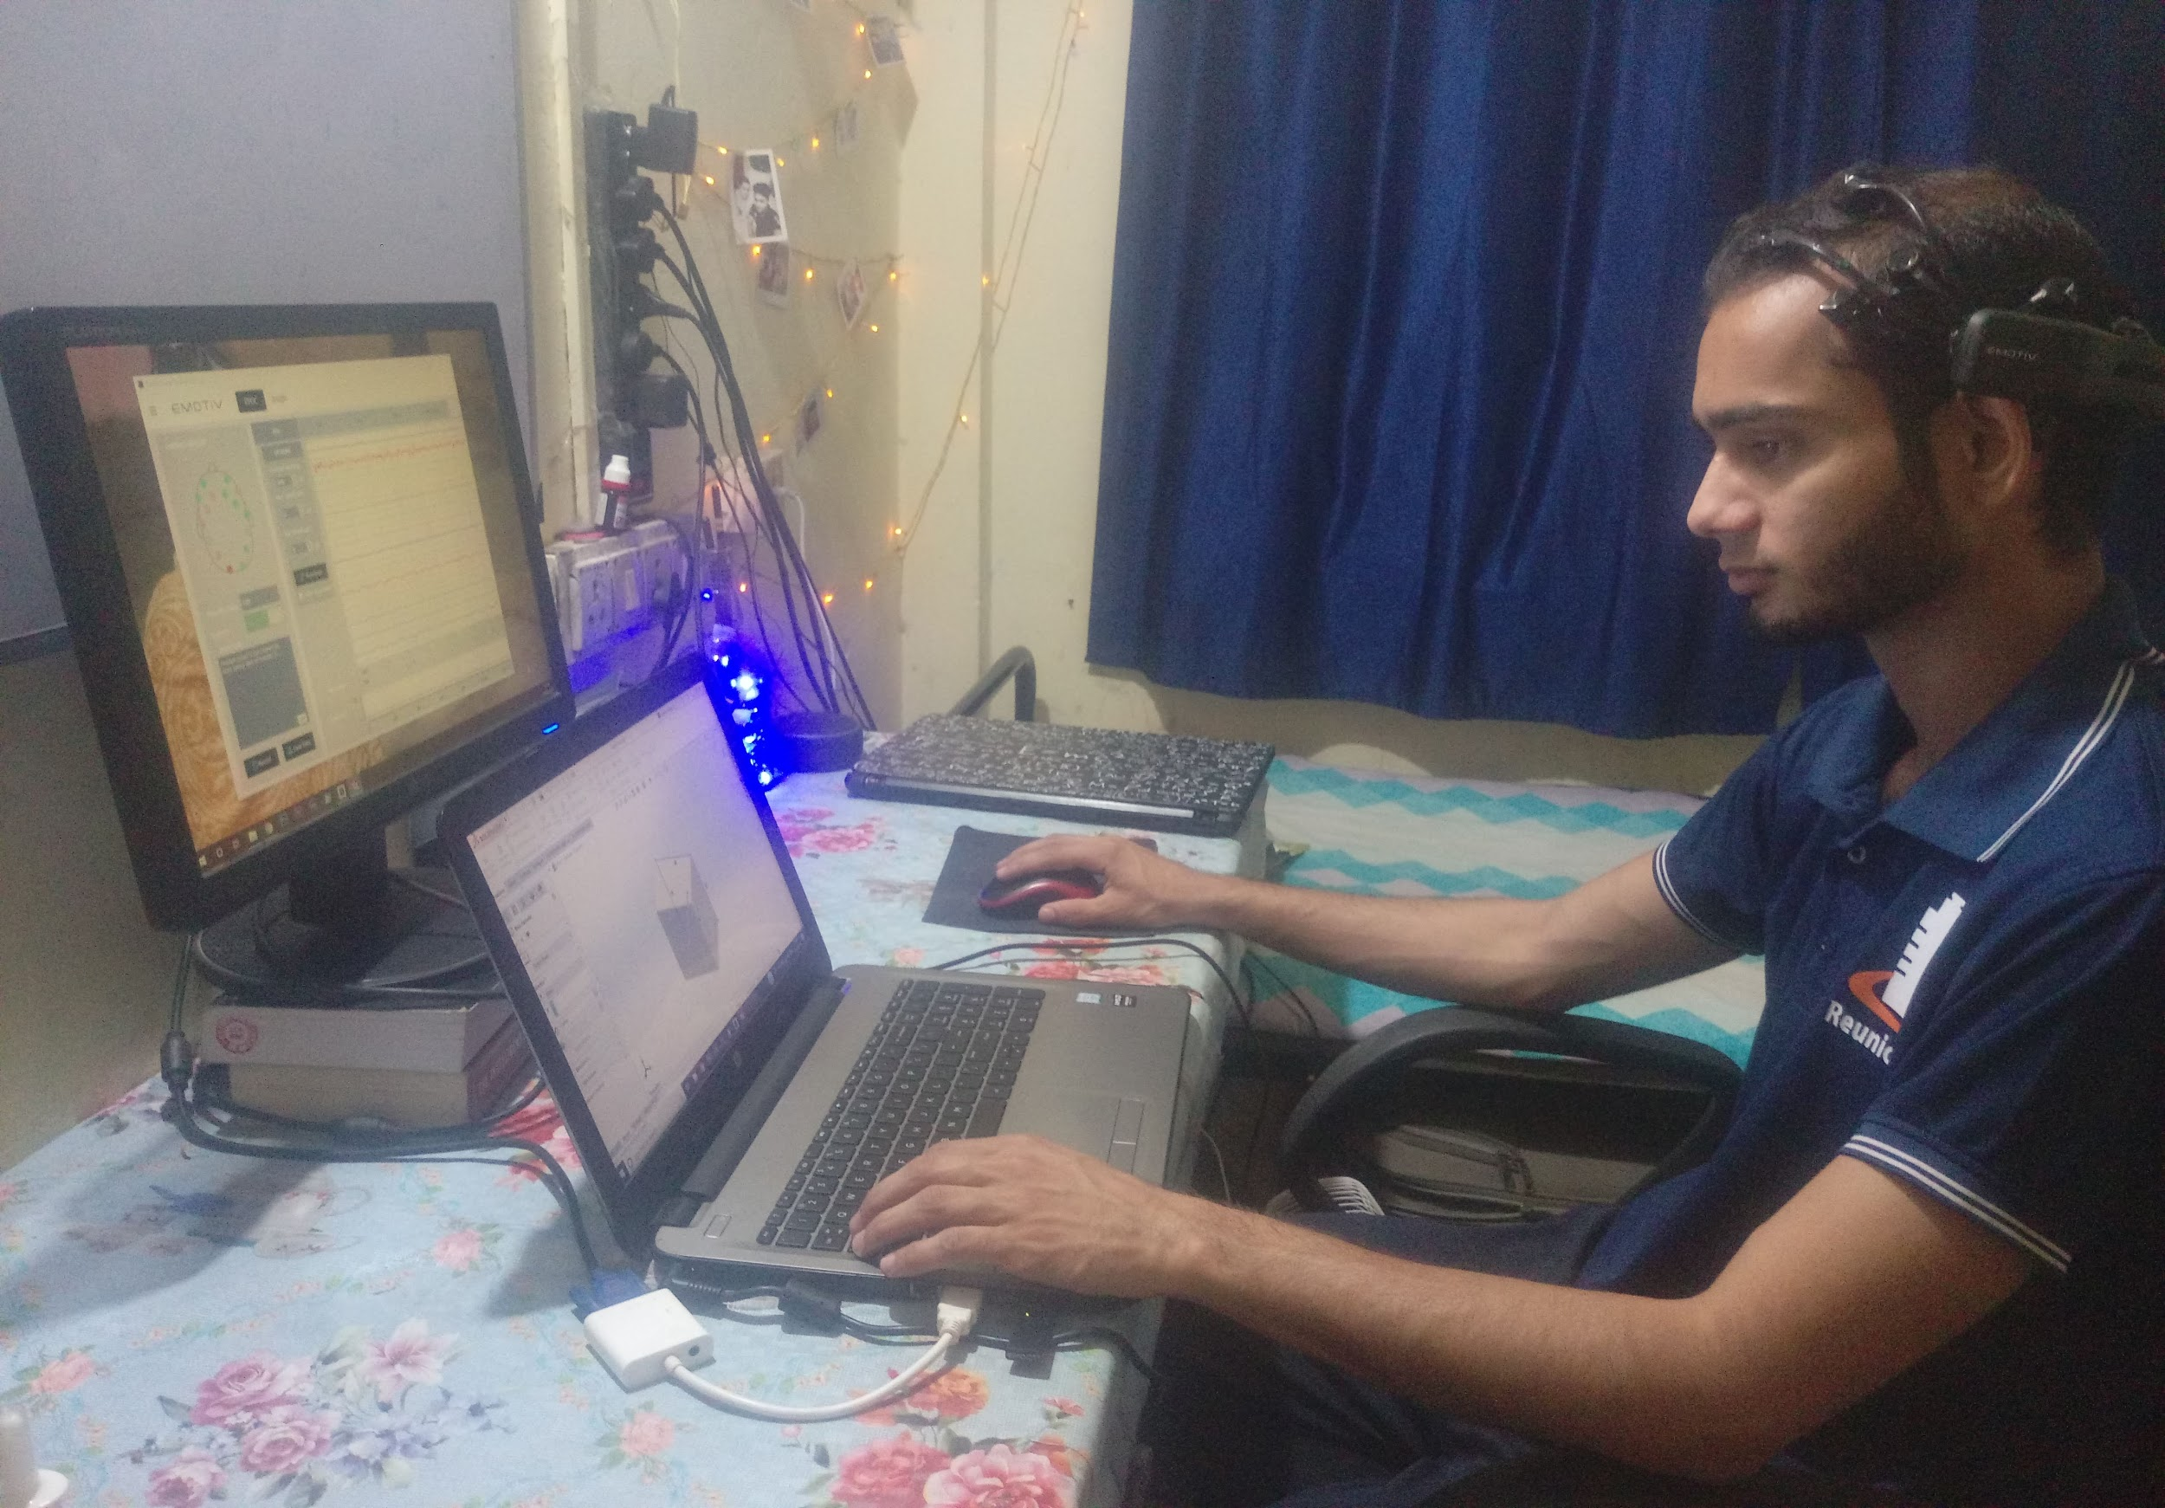
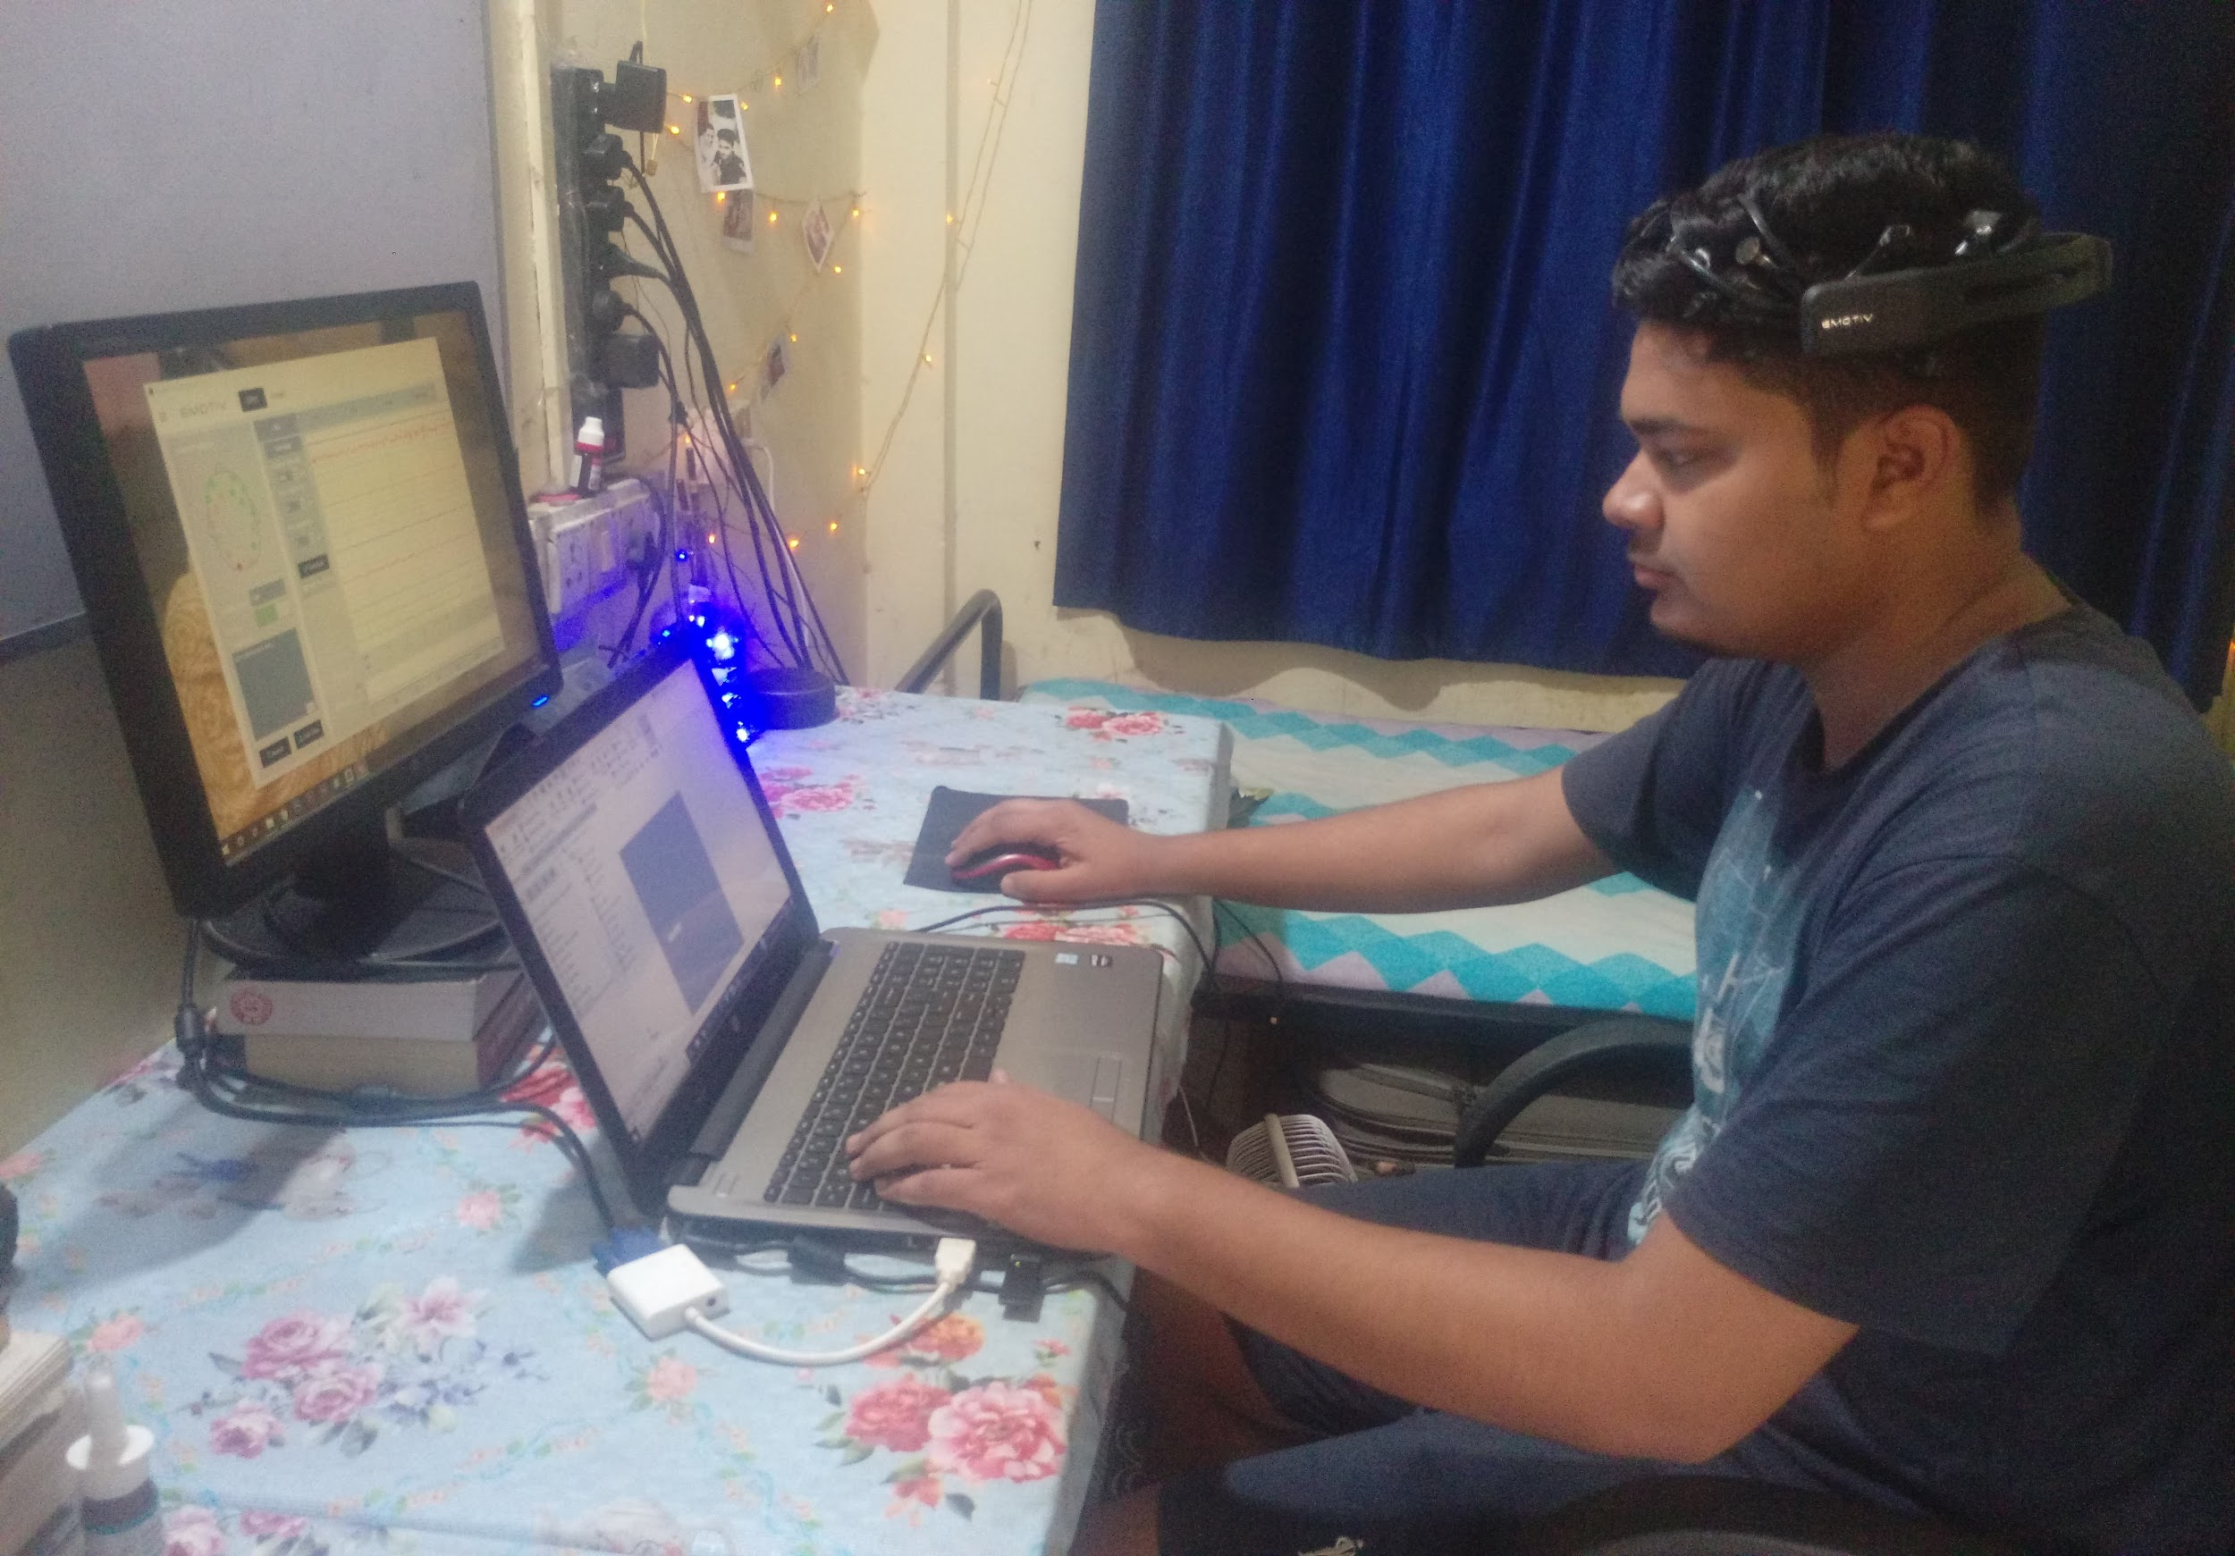

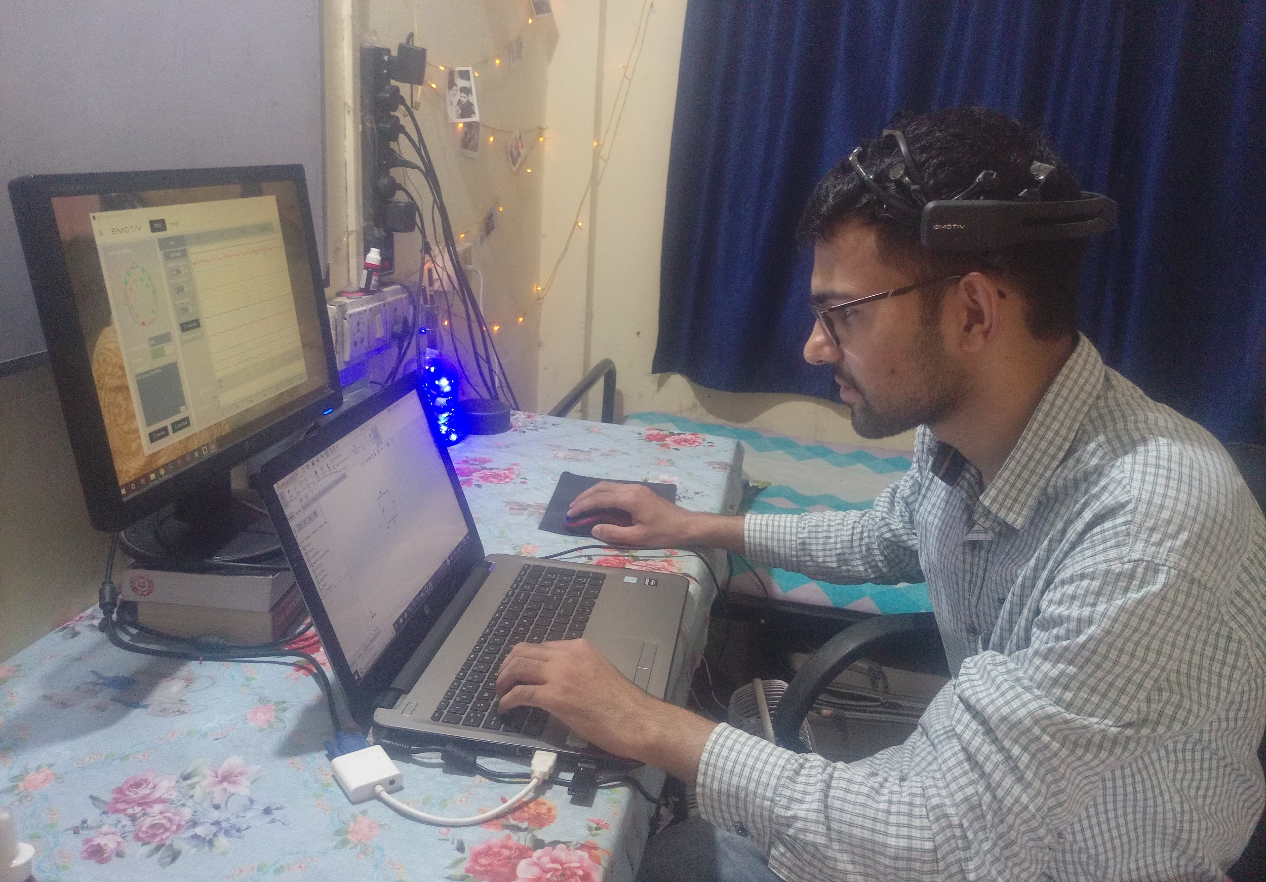
Subjects

Slide 20

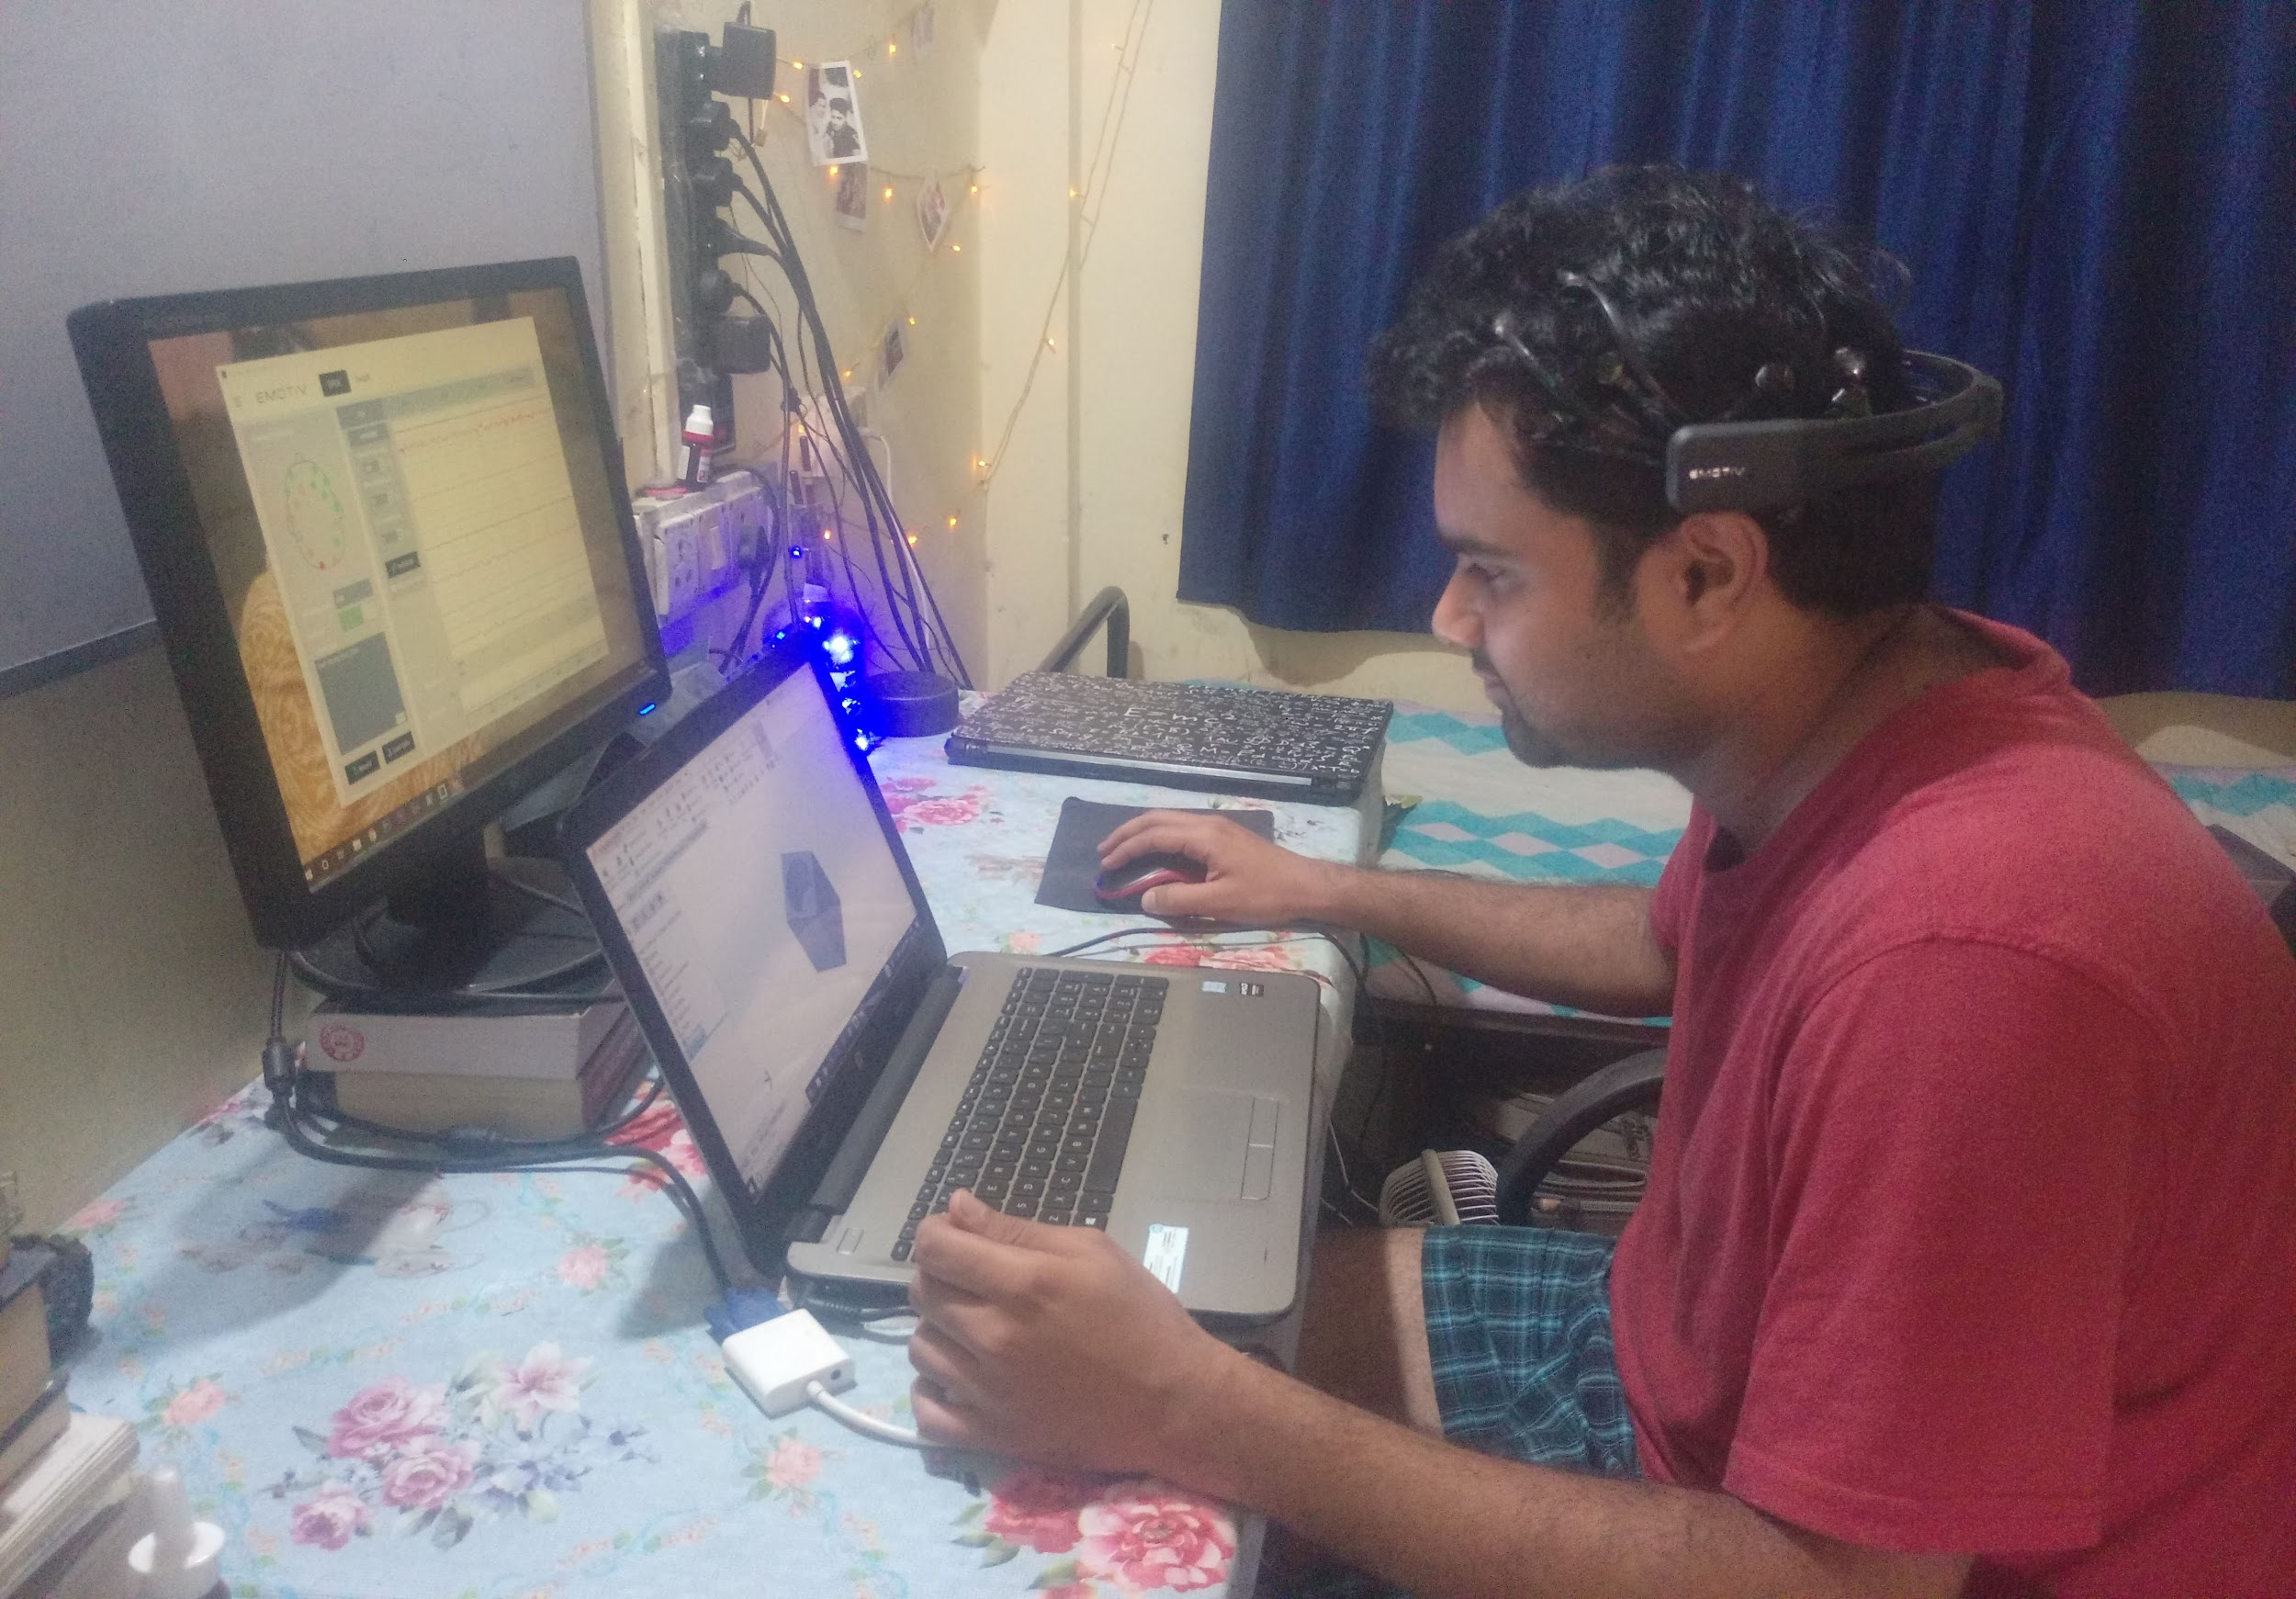

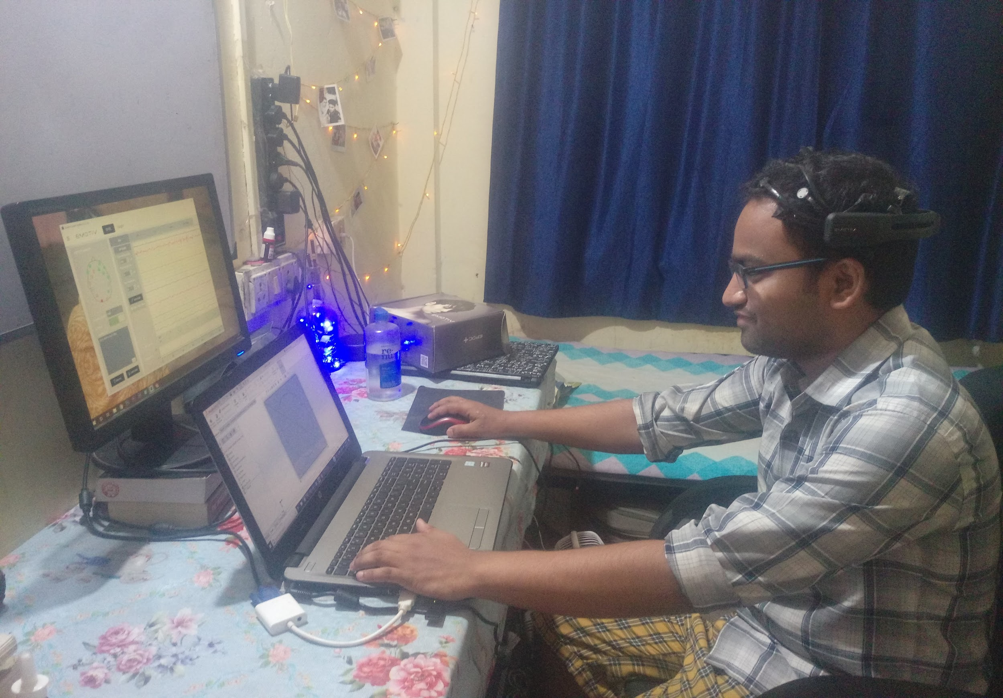
Subjects

Slide 21
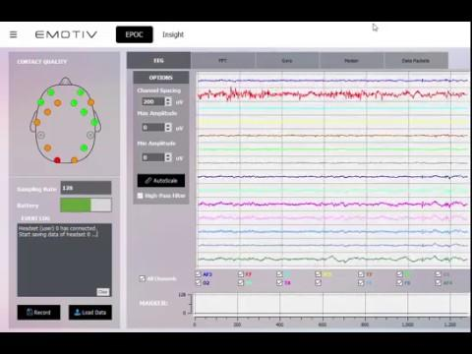
Video of data collected

Slide 22

Task
Notes:
https://drive.google.com/open?id=12S4Ors69zbU-Q2HFujJUTEI6NecEqnHB

Slide 23
Data ( for each subject )
The data collected from each subject with 14 EEG channels for
Level 1 of mental workload is - 89600 samples
For level 2 of mental workload - 197120 samples
For level 3 of mental workload - 304640 samples.
As explained below:- Let Am×n be a matrix of size m × n representing data from each
channel. Where,
m = number of samples
n = number of EEG channels
m = time × sampling rate
= 50(Level 1) / 110(Level 2) / 170s(Level 3) × 128Hz
= 6400 / 14080 / 21760
n = 14
m × n = 6400 / 14080 / 21760 × 14
= 89600(easy) / 197120 (medium)/ 304640 (hard) samples

Slide 24


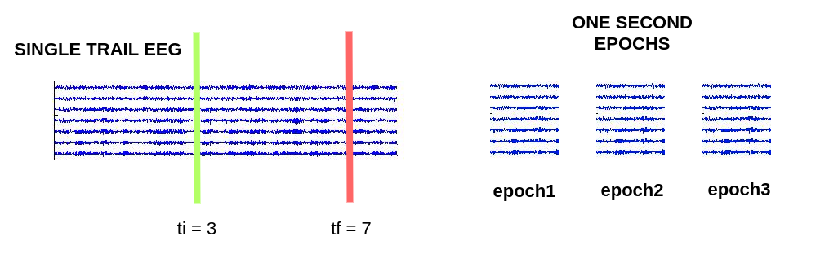

Signal Preprocessing
t=n t=n+1
t=0
t=t+1
Notes:
Add image of single trial eeg data from the matlab code. remove the epoch data
Use matlab code to do that

Slide 25
Artifact removal
Fully Online and Automated Artifact Removal for Brain Computer Interfacing (FORCe)
The FORCe algorithm works on a novel combination of wavelet decomposition, independent component analysis and thresholding of EEG signals.

Slide 26
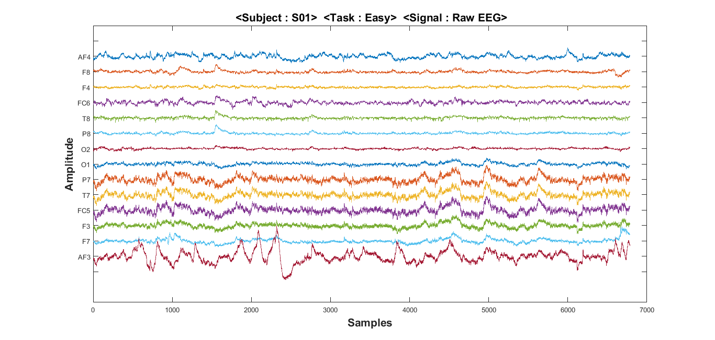
Raw data

Slide 27
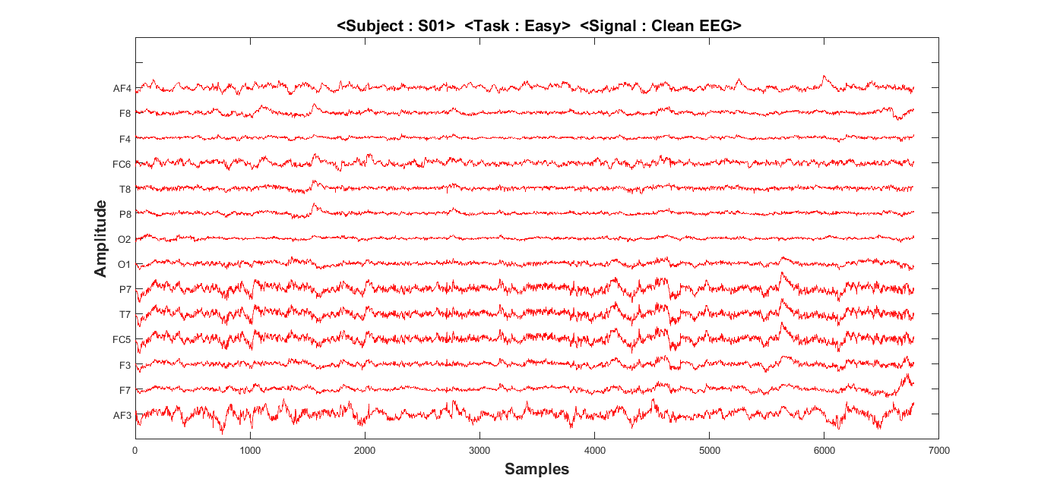
Cleaned data
Notes:
Mark in circle

Slide 28
Feature Extraction

Slide 29
Feature Engineering
Sl. No | Features | Short description
1 | COEFF OF VARIATION | a statistical measure of the deviation of a variable from its mean, standard deviation divided by mean
2 | SKEWNESS | a measure of asymmetry of the distribution
3 | KURTOSIS | a measure of flatness of the distribution
4 | Fractal dimension | No. of points
5 | 1st DIFF MEAN | Mean value of the first derivative of the signal
6 | 1st DIFF MAX | Maximum value of the first derivative of the signal
7 | MEAN ABS XCORR EEG-EEG | Mean value of auto-correlation or cross-correlation function
Notes:
Basic features of statistical analysis.

Slide 30
Sl. No | Features | Short description
8 | 1st DIFF MEAN | Mean value of the first derivative of the signal
9 | 1st DIFF MAX | Maximum value of the first derivative of the signal
10 | 2nd DIFF MEAN | Mean value of the second derivative of the signal
11 | 2nd DIFF MAX | Maximum value of the second derivative of the signal
12 | HJORTH_abi | Ability
13 | HJORTH_mob | Mobility (σx ′ /σx )
14 | HJORTH_comp
15 | ZERO CROSSING | Number of zero crossings in a signal
16 | MIN MAX NUMBER | Number of local minima and maxima
17 | COEFF_OF_VARIATION | Measure of the deviation of a variable from its mean,
18 | AMPL RANGE | The difference between the maximum positive and maximum negative Amplitude values
Notes:
Interval or period analysis features.

Slide 31
Sl. No | Features | Short description
19 | WAV COEFF OF VARIATION | Coefficient of variation
20 | WAV TOTAL ENERGY | Total Energy
21 | 2nd DIFF MEAN | Mean value of the second derivative of the signal
22 | 2nd DIFF MAX | Maximum value of the second derivative of the signal
Notes:
Features derived from the first and second derivative.

Slide 32
Sl. No | Features | Short description
23 | ENTROPY SPECTRAL | The spectral entropy
24 | ENTROPY SHANNON | The Shannon entropy
25 | MAX ABS XCORR EEG-EEG | Maximum positive amplitude of auto-correlation or cross-Correlation function
Notes:
Other Features.

Slide 33
Sl. No | Features | Short description
26 | FFT DELTA | 0.1 - 3 Hz
27 | FFT THETA | 3 - 7 Hz
28 | FFT ALPHA | 7 - 12 Hz
29 | FFT BETA | 12 - 30 Hz
30 | FFT GAMMA | 30 - 40 Hz
31 | FFT WHOLE | 0.1 - 40 Hz
Notes:
FFT-based features calculated from the EEG spectra.

Slide 34
Sl. No | Features | Short description
32 | FFT DT RATIO | DELTA / THETA
33 | FFT DA RATIO | DELTA / ALPHA
34 | FFT TA RATIO | THETA / ALPHA
35 | FFT DTA RATIO | (DELTA + THETA) / ALPHA
36 | FFT SEF | Spectral edge frequency (95 % of the total spectral power resides)
37 | FFT SP-ROLL OFF | The frequency below which 85 % of the total spectral power resides
Notes:
FFT-based Spectral Features.

Slide 35
Sl. No | Features | Short description
38 | MIN WAV VALUE | Minimum value
39 | MAX WAV VALUE | Maximum value
40 | MEAN WAV VALUE | Mean value
41 | MEDIAN WAV VALUE | Median value
42 | STD WAV VALUE | Standard deviation
43 | SKEWNESS WAV VALUE | Skewness
44 | KURTOSIS WAV VALUE | Kurtosis
45 | WAV BAND | Relative energy
Notes:
Wavelet based Features.

Slide 36
Sl. No | Features | Short description
46 | ENTROPY SPECTRAL WAV | The spectral entropy
47 | 1st DIFF WAV MEAN | Mean value of the 1st derivative
48 | 1st DIFF WAV MAX | Maximum value of the 1st derivative
49 | 2nd DIFF WAV MEAN | Mean value of the 2nd derivative
50 | 2nd DIFF WAV MAX | Maximum value of the 2nd derivative
51 | ENERGY PERCENT WAV | Percentage of the total energy of a detail/approximation
52 | WAV ZERO CROSSING | Zero crossing
Notes:
Wavelet based Features.

Slide 37
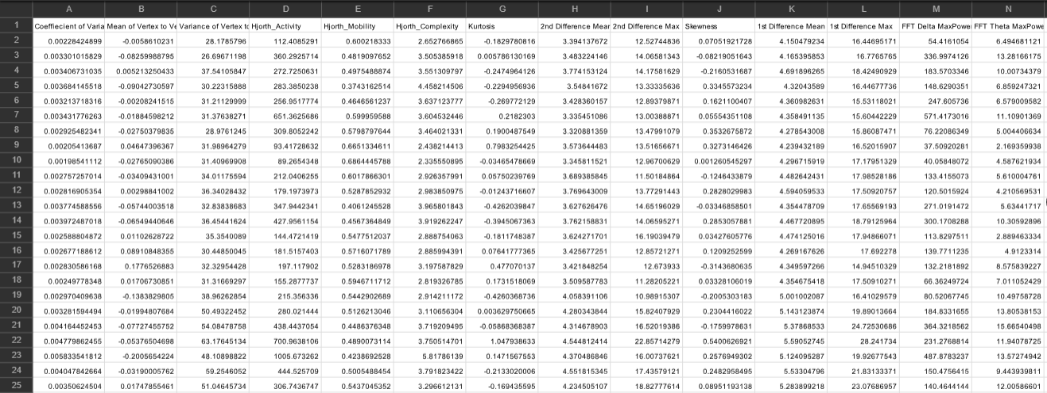
Feature Extraction
Notes:
Take screenshot of the above image from the excel sheet containing the features

Slide 38
Target Data
Level 1 - The Mental workload induced in this space is very minimum(1)*
Level 2 - The Mental workload induced in this space is moderate (2)*
Level 3 - The Mental workload induced in this space is very extreme (3)*
* hypothesis

Slide 39
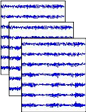
Data split for training and Testing
Training Data
Test Data

Slide 40
Feature Selection
Feature selection is important because
It decreases the number of features that have to be measured and processed.
It improves computational speed in lower dimensional feature spaces
It may increase in the accuracy of the classification algorithms.
Feature Selection Method Used:
Tree-based feature selection (Extra Trees Classifier)
Extreme Gradient Boosting (XGBoost)
Correlation Matrix

Slide 41
Tree-based feature selection (Extra Trees Classifier)
Repeatedly constructs a model and removes features with low importance
The algorithm is configured to explore all possible subsets of the attributes
It used Gini Index to to measure the quality of split of nodes
Feature importance is calculated : number of samples passing through a node/ total samples.

Slide 42
Extreme Gradient Boosting (XGBoost)
Feature importance provides a score that indicates how useful or valuable each feature was in the construction of the boosted decision trees within the model.
This importance is calculated explicitly for each attribute in the dataset, allowing attributes to be ranked and compared to each other.
Importance is calculated for a single decision tree by the amount that each attribute split point improves the performance measure, weighted by the number of observations the node is responsible for.
The more an attribute is used to make key decision, the higher its relative importance
Notes:
https://machinelearningmastery.com/feature-importance-and-feature-selection-with-xgboost-in-python/

Slide 43
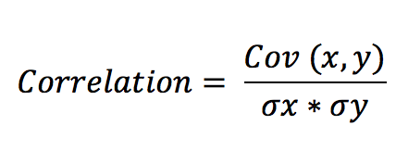
Correlation Matrix
Features with high correlation are more linearly dependent
it is obtained by dividing the covariance of the two variables by the product of their standard deviations
Eliminating features having low correlation with the target variable

Slide 44
Extra Trees | XGBoost | Correlation Heatmap
Wavelet Detailed STD | AR | Wavelet App. Entropy
Wavelet Detailed Energy | Wavelet Detailed STD | Hjorth_activity
Wavelet App. Entropy | Variance of Vertex to vertex slope | Variance of Vertex to vertex slope
Auto Regressor | Wavelet Appx. STD | Wavelet Detailed Energy
Wavelet Appx. STD | Kurtosis | Wavelet Appx. STD
Variance of Vertex to vertex slope | Hjorth_mobility | FFT Beta Max Power
Delta/ Theta | Wavelet App. Entropy | 1st Difference Max
Wavelet Appx. mean | Delta/ Theta | FFT Alpha Max Power
FFT Delta Max Power | Wavelet App. Energy | Coefficent of Variation
Delta / Alpha | Wavelet Appx. Mean | FFT Theta Max Power

Slide 45
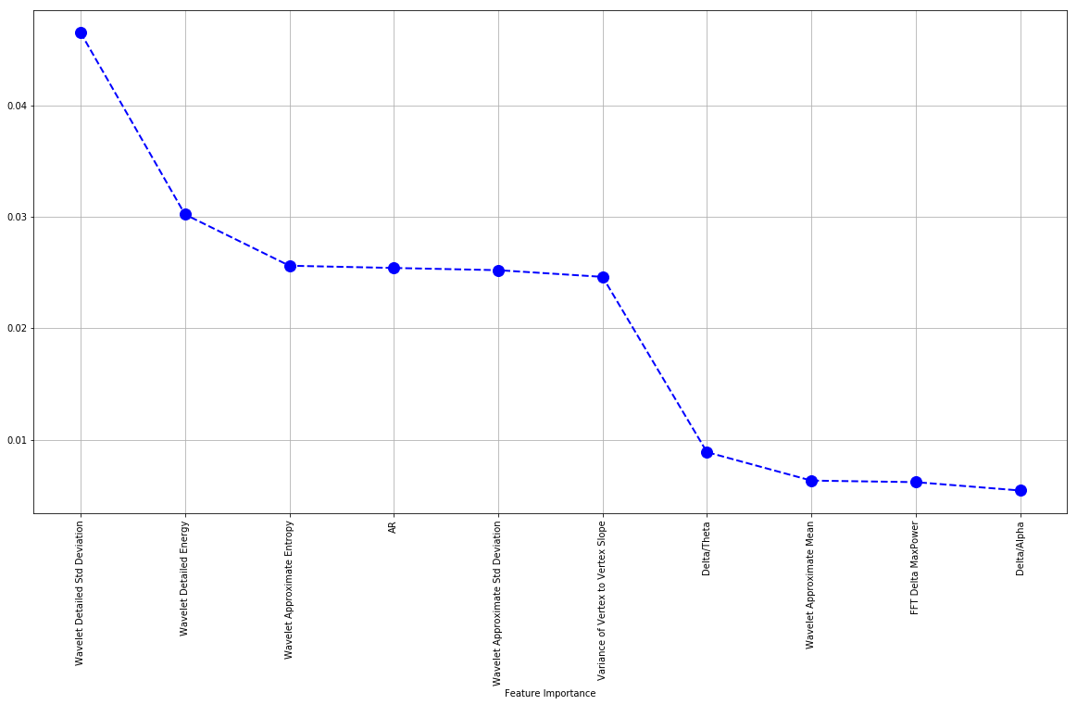
Feature Importance using Extra trees classifier

Slide 46
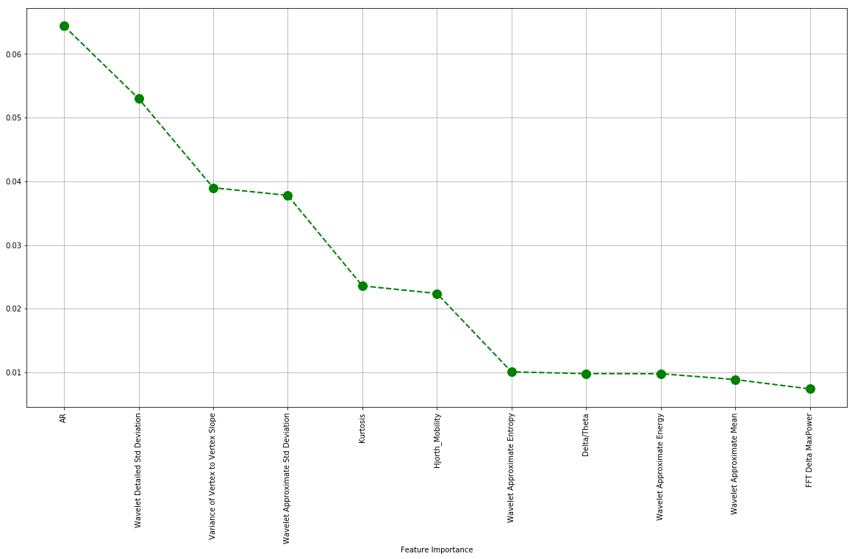
Feature Importance using XGBoost

Slide 47
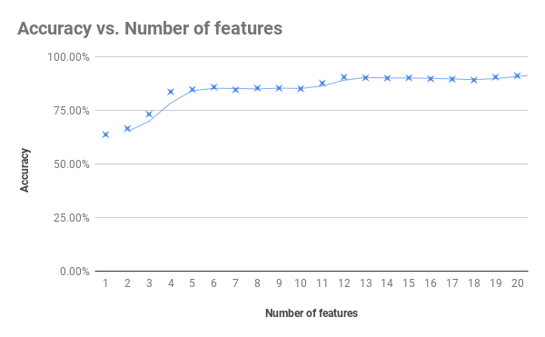
XGBoost Accuracy vs number of features

Slide 48
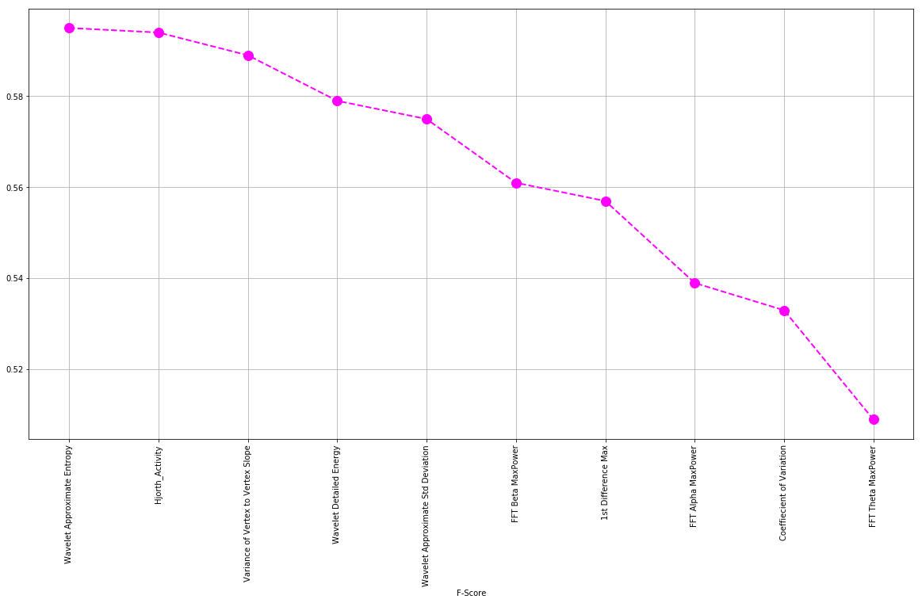
Feature Importance using Correlation

Slide 49
Selected Optimized Features
Kurtosis | Hjorth_Mobility
Wavelet Detailed Std Deviation | Wavelet Approximate Entropy
Variance of Vertex to Vertex Slope | Wavelet Approximate Std Deviation
Delta/Theta | Coefficient of Variation
Delta/Alpha | FFT Alpha MaxPower
1st Difference Max | Wavelet Approximate Energy
Wavelet Detailed Energy | FFT Beta MaxPower

Slide 50
Machine learning
Models used
k-Nearest Neighbors (k-NN)
Decision Tree Classifier
Support Vector Machine (SVM)
Multi Layer Perceptron (MLP)
GaussianNB

Slide 51
Results
Classifier | Accuracy using all features | Time taken with all features | Accuracy using selected features | Time taken using selected features
GaussianNB | 57.32% | 0.019 s | 53.74% | 0.007 s
Decision Tree | 79.44% | 0.121 s | 73.21% | 0.018 s
SVM | 82.24% | 1.041 s | 70.56% | 0.198 s
KNN | 86.13% | 0.456 s | 75.08% | 0.044 s
MLP | 84.73% | 1.937 s | 71.81% | 1.339 s
XGBoost | 88.01% | 0.359 s | 83.33% | 0.046 s
Notes:
Add time

Slide 52
Confusion matrix (XGB) ( all features)
Actual target
 | Level 1 | Level 2 | Level 3
Level 1 | 93 | 03 | 08
Level 2 | 0 | 188 | 41
Level 3 | 0 | 25 | 284
Predicted
Accuracy(test) : 88.01%
Notes:
Add time

Slide 53
Confusion matrix (XGB) ( optimized features)
Actual target
 | Level 1 | Level 2 | Level 3
Level 1 | 93 | 04 | 07
Level 2 | 0 | 170 | 59
Level 3 | 0 | 37 | 272
Predicted
Accuracy(test) : 83.33%
Notes:
Add time

Slide 54
Thank you!

